Slide 1
What's Next?
Android Developer Fundamentals
Lesson 14
This work is licensed under a Creative Commons Attribution-NonCommercial 4.0 International License

Slide 2
14.1 Firebase and Monetization

Slide 3
Contents
Firebase
Make money from your app

Slide 4

Firebase
This work is licensed under a Creative Commons Attribution-NonCommercial 4.0 International License

Slide 5
What is Firebase?
Firebase is a platform that provides tools to help you
develop your app
grow your user base
earn money from your app

Slide 6
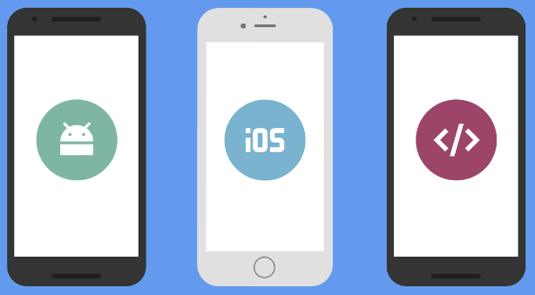
Tools for all platforms
Firebase features are available for
Android
iOS
Web

Slide 7
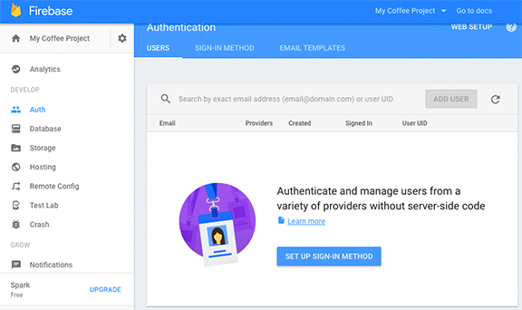
Firebase console
Firebase Console is a web front end for managing your Firebase projects

Slide 8
Using Firebase
Connect your app to your Firebase project
Enable Firebase features in the console
Add code to your app (where needed)

Slide 9
Get started with Firebase

Slide 10
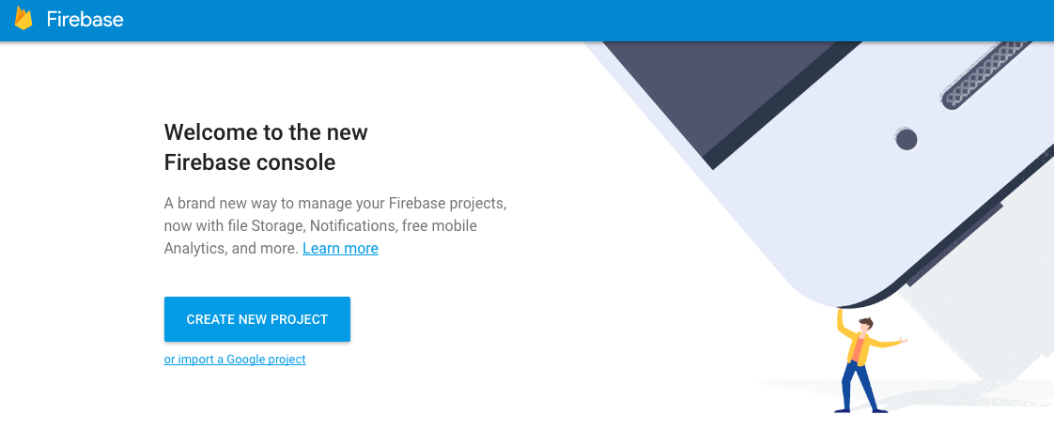
Firebase console
firebase.google.com

Slide 11
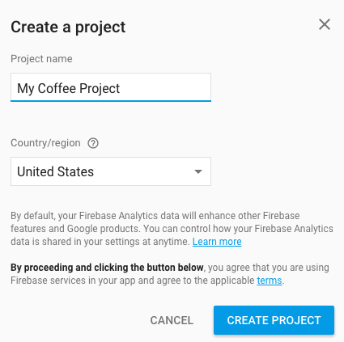
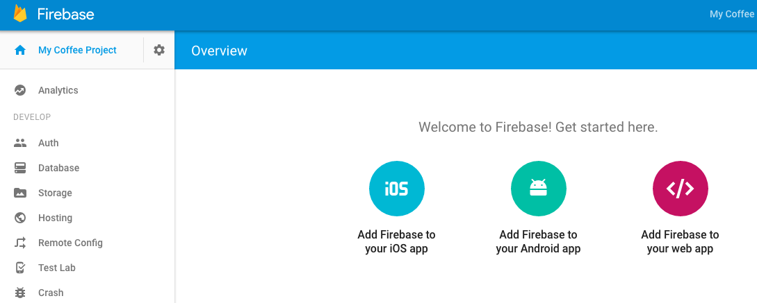
Create new project

Slide 12
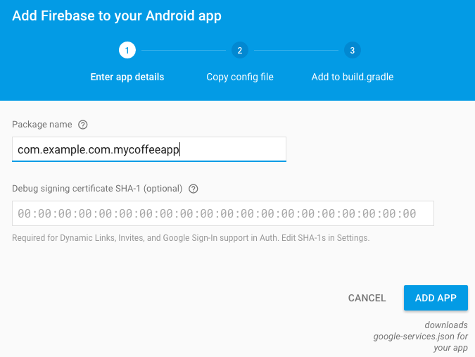
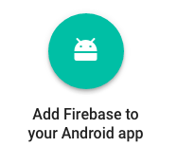
Connect your app to the Firebase project
Add your Android app to your Firebase project

Slide 13
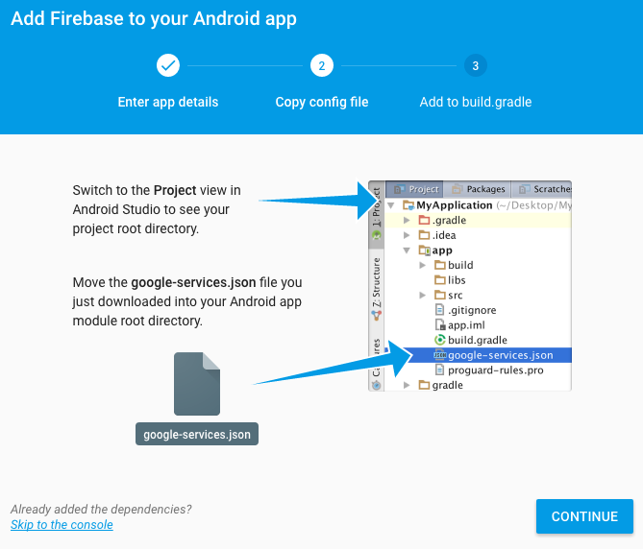
Firebase config file
Firebase creates a config file for your app
It contains all the information your app needs to integrate with the Firebase project
google-services.json file

Slide 14
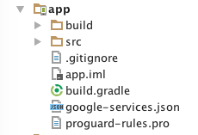
Add config file to your project
Open your app in Android Studio
Drag and drop google-services.json to the app module

Slide 15
Update code dependencies in your app
The Google services plugin for Gradle in your project loads google-services.json
Modify your build.gradle files to use the plugin
Follow the instructions in the Firebase wizard to update code dependencies
Notes:
The Firebase console gives you all the info you need!

Slide 16
Update build.gradle
Project-level build.gradle:
buildscript { dependencies { // Add this line classpath 'com.google.gms:google-services:n.n.n'
App-level build.gradle…
// Add to the bottom of the file
apply plugin: 'com.google.gms.google-services'
Get exact number from Firebase wizard
Notes:
Get the exact number from the Firebase wizard
Let's take a look now at Firebase features

Slide 17
Firebase Analytics

Slide 18
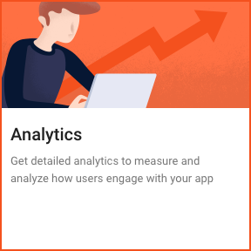
Firebase Analytics
Unlimited free reporting
Audience segmentation
Define custom audiences based on device data, custom events, or user properties
firebase.google.com/docs/analytics/

Slide 19
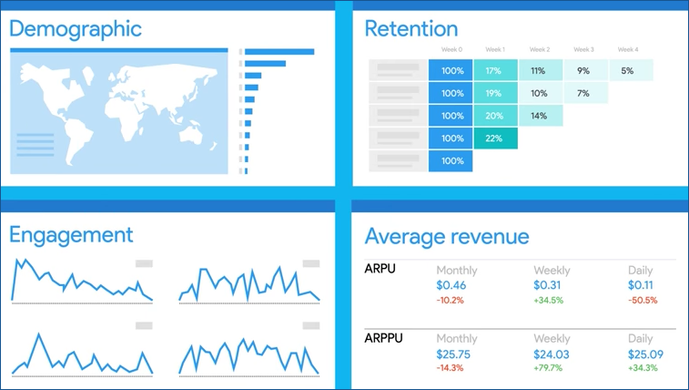
Firebase Analytics: default reports
Get reports without adding code
geographic
demographic
engagement
revenue

Slide 20
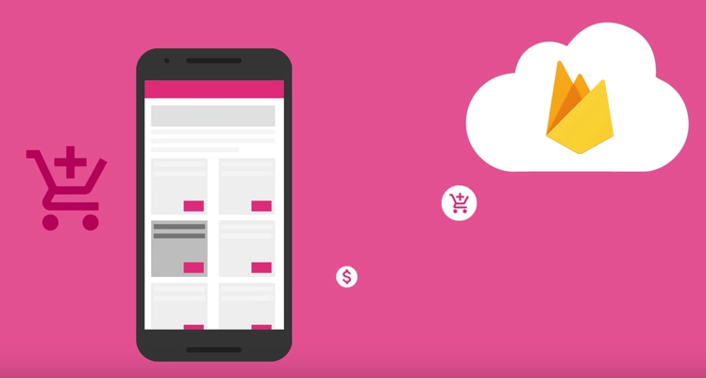
Firebase Analytics: custom reports
Add code to log events in your app to get more reports
Predefined events such as: user adds an item to their cart
Custom events such as: user achieves a level in a game

Slide 21
In your app
In your app project, add dependency in app/build.gradle: compile 'com.google.firebase:firebase-analytics:n.n.n'
No need to write code for default reports
Write code for custom events if you want them

Slide 22
Firebase Notifications

Slide 23
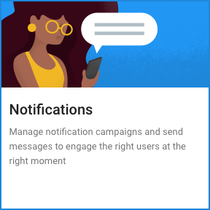
Firebase notifications
In the Notifications lesson, you learned how your app can send notifications to the user.
The Firebase Console lets you send notifications to your users.
Notes:
You learned in a prevous lesson how your app can send notifications, but you

Slide 24
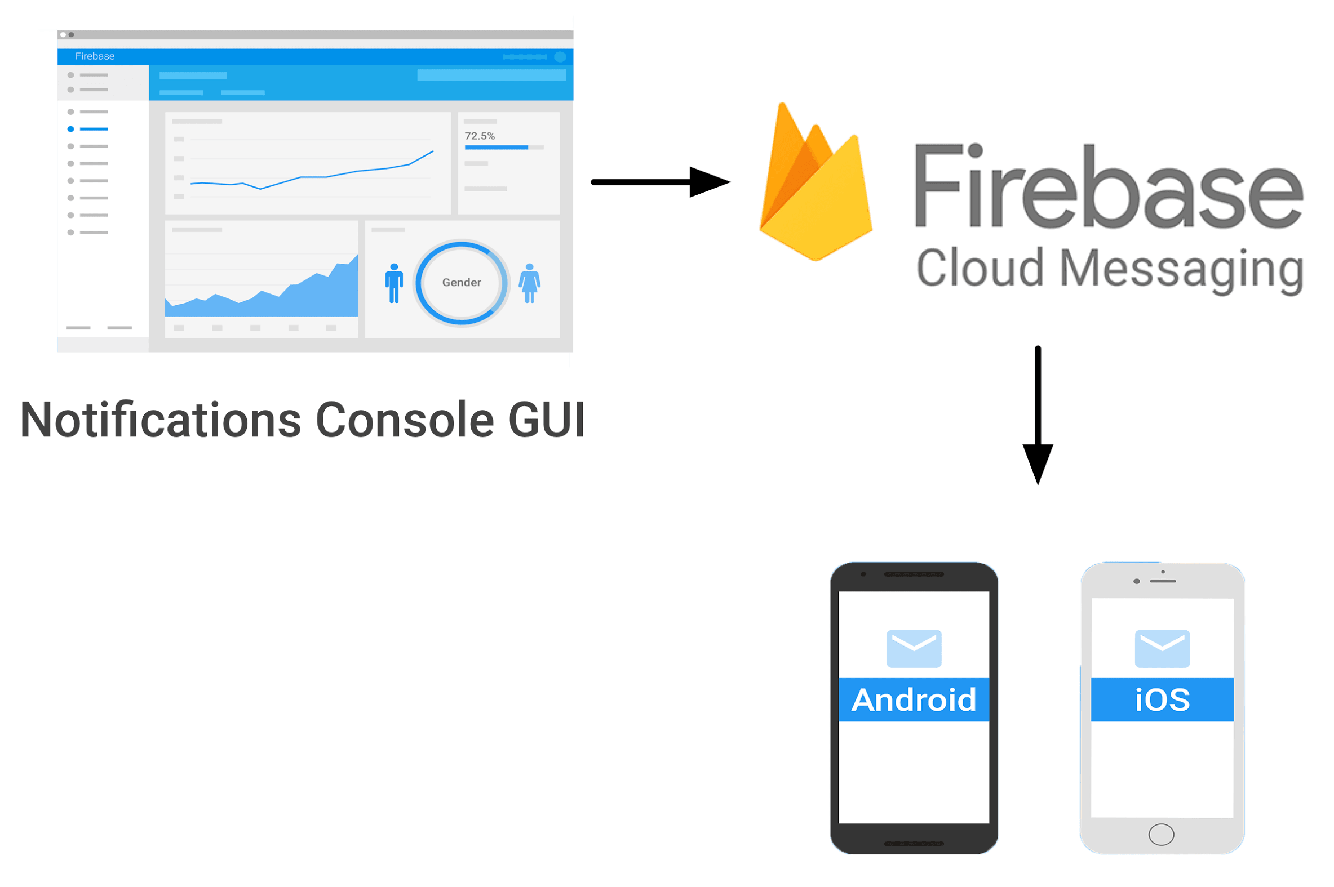
Firebase Cloud Messaging sends the msg
You write notification messages in the Firebase Console
Firebase Cloud Messaging delivers the notifications to the target audience
Notes:
Firebase Cloud Messaging handles the routing and delivery to targeted devices.

Slide 25
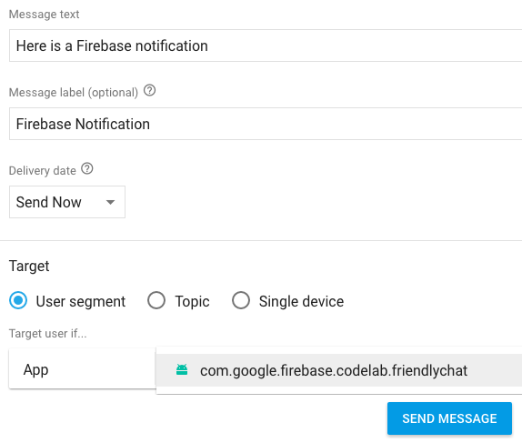
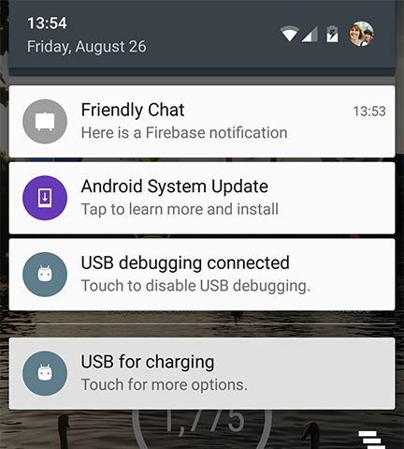
Send message
Write your message in the Firebase console
Notes:
Send the messsage
It is delivered to targeted devices!

Slide 26
Firebase Database

Slide 27
Storing and sharing data
You have already learned your app can
save data in an SQLite database on the device
use a ContentProvider to share data with other apps
How do you enable different users using different devices, to share and update data?
Use Firebase Database

Slide 28
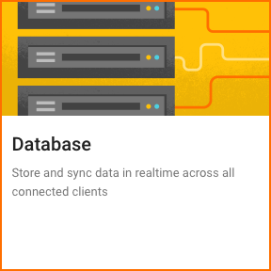
Firebase Realtime database
Store and sync data with the Firebase cloud database
Data is synced across all clients, and remains available when your app goes offline
firebase.google.com/docs/database/

Slide 29
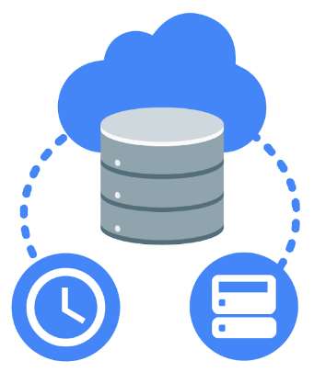
Connected apps share data
Firebase Realtime Database is hosted in the cloud
Data is stored as JSON
Data is synchronized in realtime to every connected client.

Slide 30
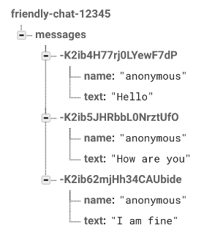
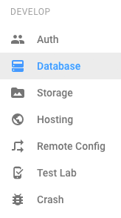
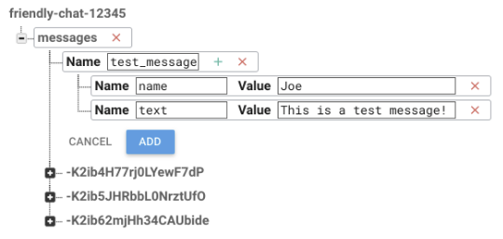
View and edit data in Firebase Console

Slide 31
In your app
In your app project, add dependency in app/build.gradle: compile 'com.google.firebase:firebase-database:n.n.n'
In your app source code, put data in the database, and get data from the database (API Reference)
Example:
FirebaseDatabase database = FirebaseDatabase.getInstance();
DatabaseReference myRef = database.getReference(path);
myRef.setValue("New value");

Slide 32
Firebase Cloud Test Lab

Slide 33

Firebase Cloud Test Lab
Test your app on real devices in a Google data center
firebase.google.com/docs/test-lab/

Slide 34
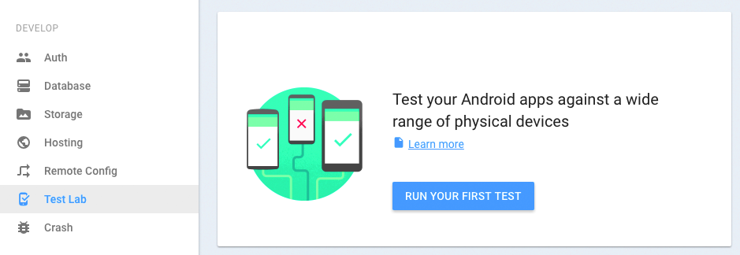
Run your tests in the console
Notes:
It's easy to run your tests in the console

Slide 35
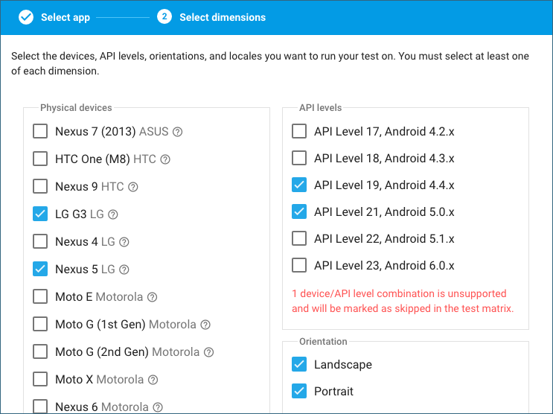
Choose the devices to test your app on
Set test targets:
Devices
API levels
Orientations
Locales
Notes:
Use Firebase Console

Slide 36
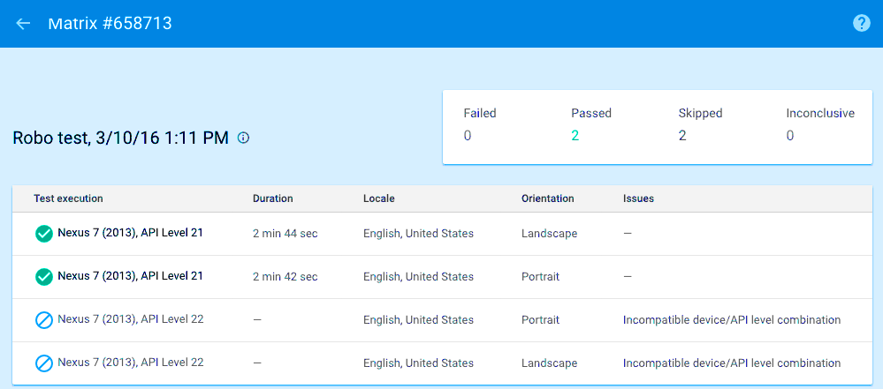
Get test results
Notes:
The firebase console gives you reports on your tests

Slide 37
And more...

Slide 38
More Firebase tools
Firebase storage —Store images, audio, video, or other user-generated content.
Store terabytes of data!
Authentication—Enable users to sign in to your app
Get crash reports

Slide 39
… and even more!
App indexing -- enable Google search to include results from your app
Dynamic links -- deep links into an app that work whether or not users have installed the app yet.
App Invites -- allow users to invite others to your app
AdMob -- we'll talk about that next

Slide 40
Learn more about Firebase
Firebase
Firebase Testing Lab
Getting started with Firebase for Android
Firebase in a weekend online course www.udacity.com/course/ud0352

Slide 41
Learn more contd...
Firebase console console.firebase.google.com/
Firebase developer documentation firebase.google.com/docs/
Firebase codelab
codelabs.developers.google.com/codelabs/firebase-android
Highly recommended!
Notes:
Take the Android codelab first, then take other firebase codelabs
They will really help you get started

Slide 42
Video Resources
Introducing Firebase: https://www.youtube.com/watch?v=O17OWyx08Cg
Playlist of intro videos to Firebase features http://goo.gl/qo4Frq

Slide 43
Make Money from your apps

Slide 44
Ways to monetize apps in Google Play
Premium model—users pay to download app
Freemium model
downloading app is free
users pay for upgrades or in-app purchases
Subscriptions—users pay recurring fee for app
Ads—app is free but displays ads

Slide 45
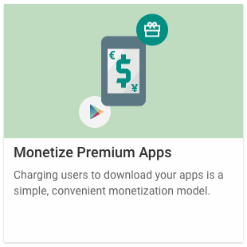
Premium apps
Charge users to download your app
Set prices in the Developer Console
Good model for apps that address a market niche
BUT users often won't download an app if they have to pay for it

Slide 46
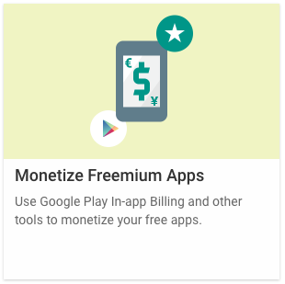
Freemium Apps
Offer a free download with
limited features
full features for a limited time
Let users upgrade to full, unlimited app with an in-app purchase
developer.android.com/google/play/billing/index.html

Slide 47
In-app purchases
Use In-app purchases to sell extra features
New features
Additional content
Skins
New levels, powers, attacks...
developer.android.com/distribute/monetize/freemium.html

Slide 48
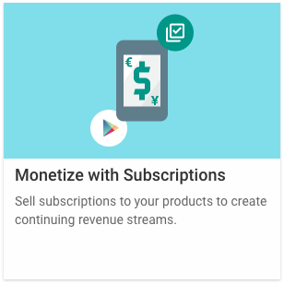
Subscriptions
Subscriptions let users use apps or features for a recurring monthly or annual fee
Offer a free trial subscription to allow users to explore your app

Slide 49
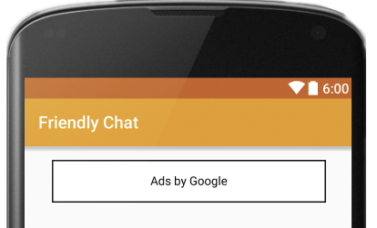
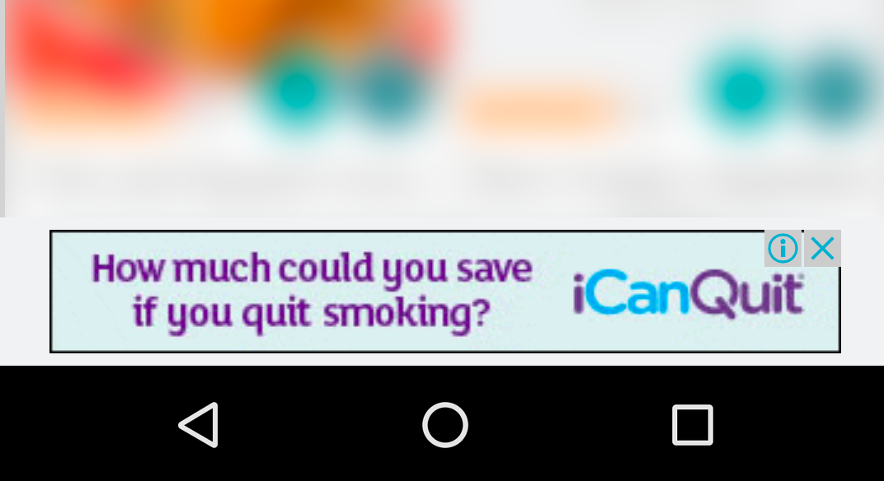
Run ads using AdMob
Runs ads in your app to earn revenue
650,000 + apps use AdMob
$1 billion+ paid to developers in the last 2 years
developer.android.com/distribute/monetize/ads.html

Slide 50
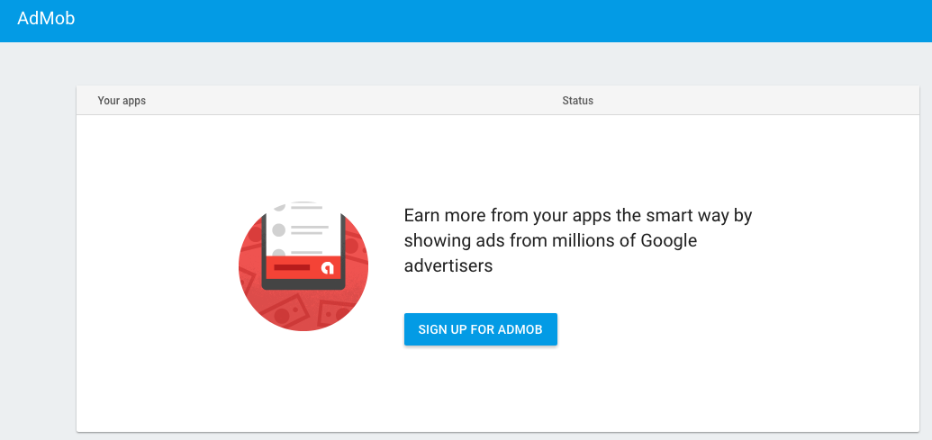
Sign up for AdMob in Firebase Console

Slide 51
Learn more about monetizing your app
Earn
Monetizing with Ads
In-App Purchases
In-App Billing

Slide 52
What's next?
This course does not have a practical for Firebase and AdMob
Get hands on experience by taking these online courses:
Firebase in a Weekend online course www.udacity.com/course/ud0352
Firebase codelab codelabs.developers.google.com/codelabs/firebase-android

Slide 53
What's next?
Concept Chapter: 14.1 C Firebase and monetization
This lesson does not have a practical
Get practical experience by taking these online courses:
Firebase in a Weekend www.udacity.com/course/ud0352
Firebase codelab codelabs.developers.google.com/codelabs/firebase-android

Slide 54
END

